Slide 1
Myghostspot.com
We let let everyone to create own ghost double into augmented reality, what you can see via your phone.
You can be the content creator and influencer making your message appear in AR at your fixed place in the world.
You can also bring to life memories of those who once lived.
Or you just create your personal memory point of visiting whatever way you want to use it.

Slide 2
How Does It Work?

Slide 3
You download the app and go to a place where you want your ghost to appear.

Slide 4
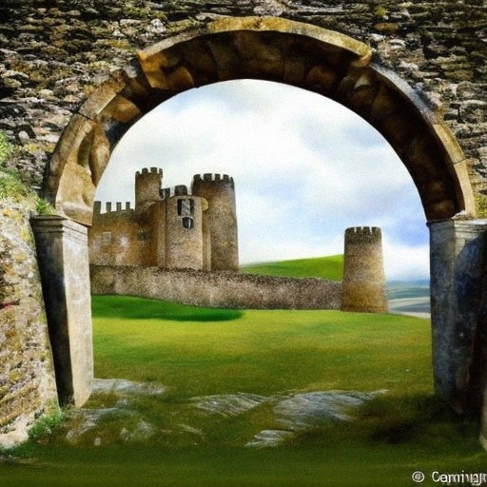
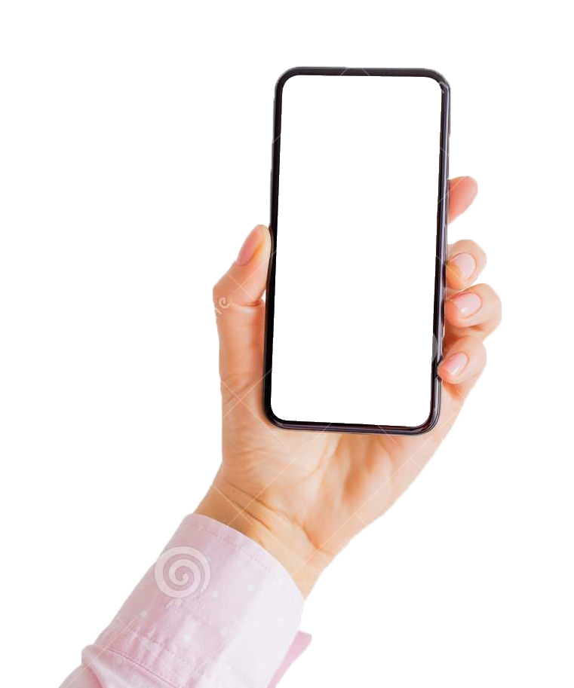
If you work as content creator for history, you can make your ghost appear and tell the story at the historic place you choose

Slide 5
If you work as content creator for the fashion, you can make your ghost appear at the shop, giving suggestions for your subscriber

Slide 6
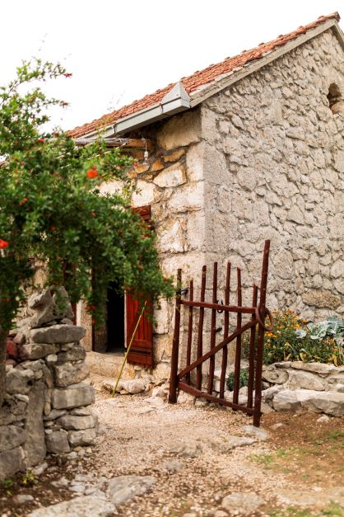
It can be an old house where you spent time as a child…

Slide 7
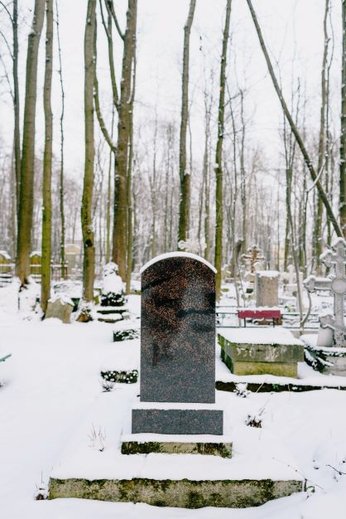
...Or the grave of a loved one

Slide 8
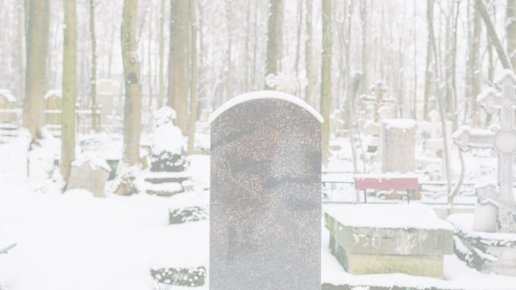
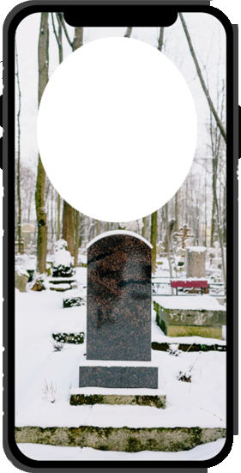
You point your camera at the place, and when you approach it, you can see its story

Slide 9
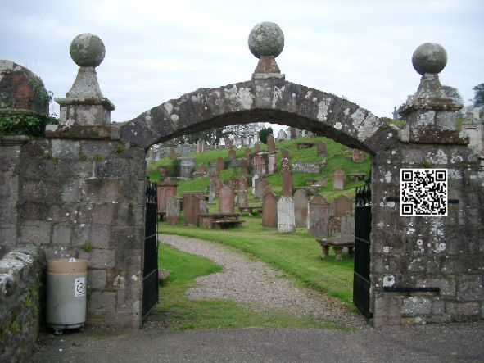
You share info about the app and your ghost point location with your subscribers. You can QR-code app download at the gate. If you are the owner of the place, you can create an animated character which can lead you to the right place using AR.

Slide 10
You can use our solution also for your own intentions in any way you like. Save your feelings or thoughts at this moment (as a kind of diary), share it with other visitors if you like. Also, you can see what other visitors have decided to share, it is like a guestbook. All this will create My ghost point.

Slide 11
How to Add Your Own Ghost Points?

Slide 12
Once you’ve downloaded the app, you can go outside and find other people’s ghost points and create your own.

Slide 13
What Content Can I Add
to My GhostPoint?

Slide 14
Images
My Ghost Avatar (created by the AI from your picture)
Videos (like you already created for TikTok, Youtube, etc)
AI-generated stories and possibility to let AI answer questions like you usually do
Comments
AI- processed text
My own Diary

Slide 15
What Is the
AI-Generated Story?

Slide 16
We can create an Ghost (avatar) of you, based of your photo. It can also be the photo of your ancestor, who’s story you know. We can turn it into a video by adding synthesized, or your own voice-based speech, following the text you provide. AI also let visitors ask questions from your ghost, and it answers in your pre-saved style, according the info it can find about youor the related content.

Slide 17
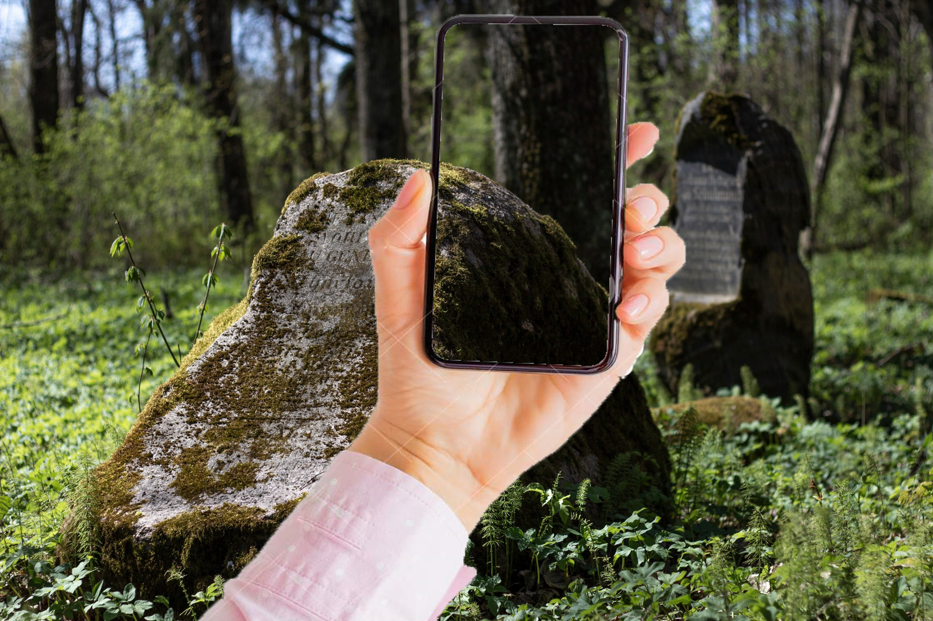
Example of the photo+text and the resulting video.
Example of the photo+text and the resulting video.

Slide 18
In case you got intrigued … see next few slides and:
https://elektit.com/en/evmemories/

Slide 19
For whom we do it?
For the content creators in every imaginable field, where the content is related with the specific spot you visit.
For people who visit their memory points of people who once lived and/or want to store personal memories or to leave a message for posterity.

Slide 20
Different, better how?
It allows content creators to widen their ways of approach to subscribers. Usingyour cntent via AR at the certain place can be useful – like telling history at the site, selling the product at the shop, letting your ghost appear at the event where you actually can not participate, etc
Using pre-recorded media in combination with AI (Artificial Intelligence service), persons who are in our memories are visualized/animated in AR (Augmented Reality environment) at the location (memory point) that is emotionally connected to the client – a cemetery, an old family house, a place of first meeting, etc
It only works when persons are actually on site, and it makes your avatar or person in memory appear (via the app), creating a unique personalized emotional experience for the visitor.
In cooperation with the history and culture content creators, we will build up first example of the service in the cemeteries of Tartu, as the densest area in the city room, where memories are invoked.

Slide 21
What is the benefit of that?
We create a new way of showing the content for the influencers, youtubers, tiktokers, etc, - it appears in augmented reality exactly at the spot whit what the content is related.
Both, the creator of memory point and all the visitors, are gaining from it. Content creator will have more subscribers, If you get more than 1000 different visitors of your Ghost spot, you start earn from every visit they make. Visitors of your ghost spot can get information, for what they are ready to pay.
Memories and messages of your ancestors can be made available and accessible to others, when they visit the memory point.
You can use your ghost spot in any way, up to your imagination.

Slide 22
Future possibilities
Since the planned application uses external service providers in animation and augmented reality functions, the content offered in the service can become more perfect through the development of the AI and AR services used. For example, you can continuously improve over time:
animated person will behave according the instructions given to AI
3D animation performance augmented reality, full body animation instead of bust form
using AI to ask questions to animated persons in real time (the answers to which are found by AI using what is found on the internet and what is recorded about the person by other users). Giving answers to more complex questions can also be directed by the AI to answer the owner of the memory point
automatic translation of the presented text, into the language of the user
creation of algorithms to connect memory points globally, merging different users into larger thematic networks
linking the solution for a smooth user experience with various social networks in use - FB, Twitter, Meta VR, Instagram, Geni, MyHeritage, etc
activated app signals when approaching memory points, which have a connection with the client
presentation of advertisements for trial customers through the speech of animated persons (i.e. after speaking their message, through the AR environment provides the viewer with audio-visual information about the products and services that could be necessary for the end consumer at this memory point
new customer groups - pet owners, bloggers, travellers, memory points of sculptures in urban space, objects and avatars that help people providing critical information in crisis situation
seminars, conferences, based upon potential use cases, ethical topics, etc of the service

