Slide 1
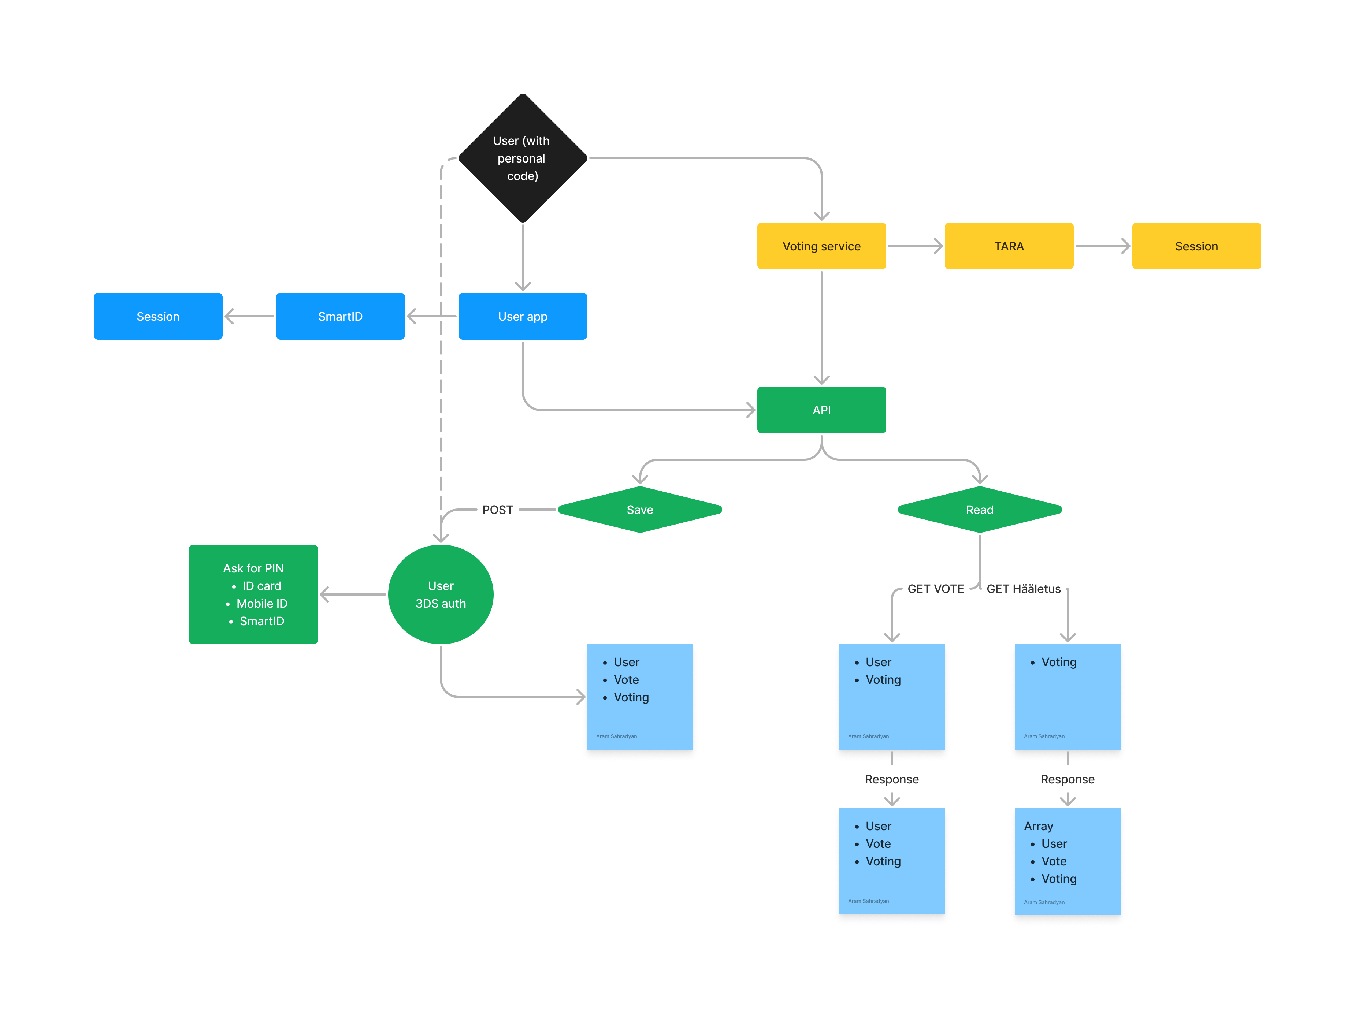
My e-vote: the simple, secure and scalable way to vote online From Estonia to the world
Powered by ElektIT OÜ
Notes:
AI-generated content may be incorrect. --- In this pitch, we will present our startup's innovative approach to addressing key challenges in [Industry/Market]. We will cover the problem we are solving, our unique solution, target customers, competition, market size, current status, future plans, team, and our current needs.

Slide 2
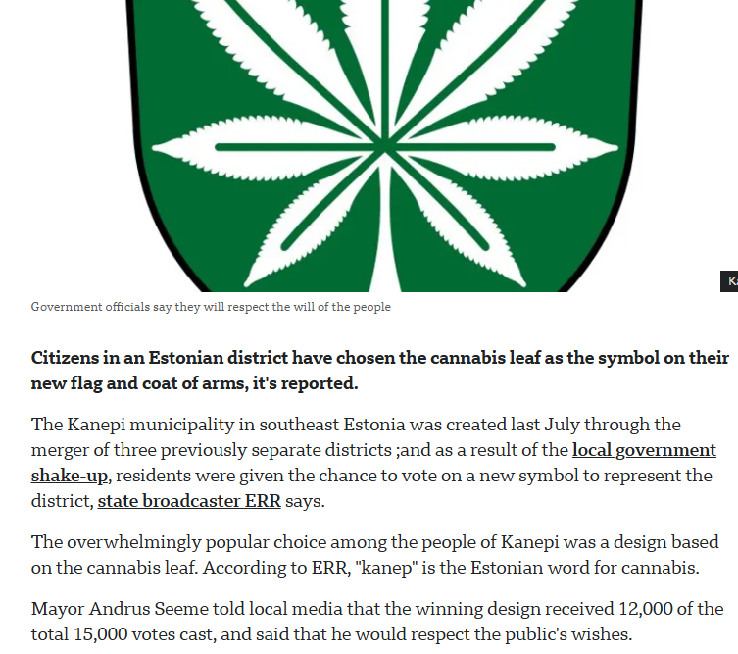
Problem Most online voting today is either too expensive, too insecure, or too complicated. Even in digital societies like Estonia, organizations struggle with: - Lack of trust in how votes are handled or counted - Legal risks (e.g., GDPR compliance) - Time and cost of secure infrastructure - Global participation limitations
Notes:
Understanding the problem is crucial for identifying the opportunity for our startup. We will highlight the market gap that exists and discuss the challenges customers currently face.

Slide 3
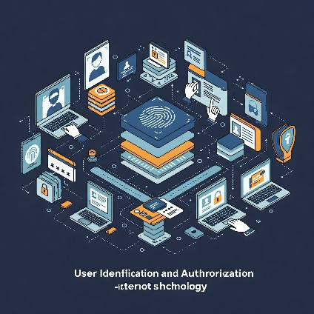
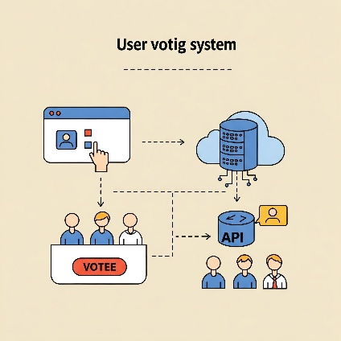
Our Solution – e-vote A modular e-voting system that works like a secure online payment. Embed into your website and run legally valid, trusted votes
My e- vote
Key components:
- Microservice API: secure voting integration
- Authentication & Vote Handling via e-ID
- Mobile App (Prototype): central access to votes
Currently in prototype phase – ready for early adopters
Notes:
Now that we've identified the problem, let's explore our innovative solution that directly addresses these challenges. Our solution is designed to be effective, efficient, and user-centered.

Slide 4
e-Vote as a secure solution can be accepted by Estonia’s official registrys (as Business Register): - Board/shareholder decisions fully online - No need for physical presence - Ideal for remote or global teams ⚖ Digital votes with legal force—no need to chase signatories.
Legally Binding. Seriously Simple.
My e- vote
Notes:
Eeldatavasti hetkel hided slide – tulevikus loodetavasti relevantne

Slide 5
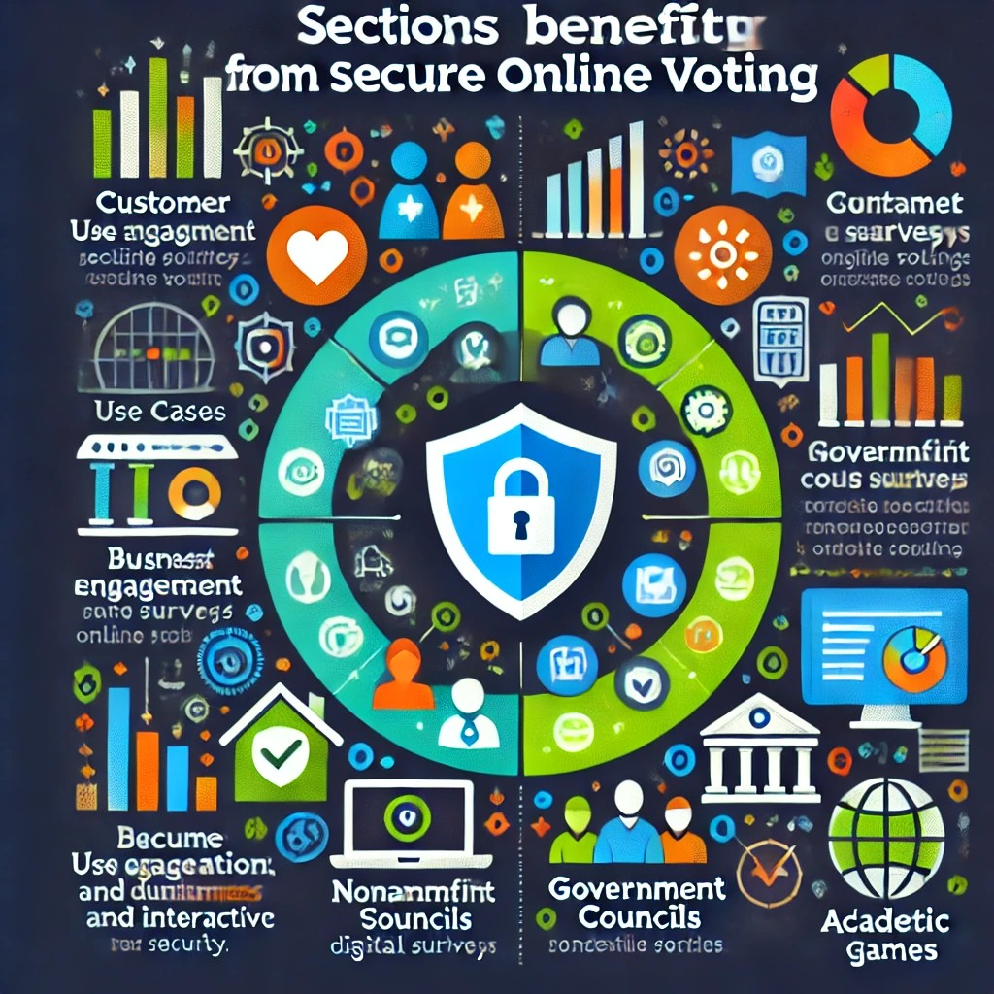
e-Vote is for organizations needing legal, secure, and effortless voting. Ideal for: - Companies: shareholder or board decisions - NGOs: internal elections or referendums - Municipalities: community engagement - Academic/professional bodies - Customer-facing businesses: digital engagement, customer games, surveys ✅ Just embed a button – no infrastructure needed.
Who We’re Built For?
Notes:
Identifying our target customer is crucial for designing our marketing strategy and product development. We will explore who they are and their specific needs.

Slide 6
Market potential
Tapping into growing demand for secure, remote voting:
🇪🇪 Estonia:
- 1.4M with e-ID
- ~7M non-governmental votes/year
🇪🇺 EU-wide (e-ID adoption):
- ~500M people
- ~2.5B digital votes/year
Starting from Estonia. Scalable for Europe and beyond.
Notes:
Understanding market size helps us identify the potential for growth and investment. We will discuss the Total Addressable Market and our reachable market segments.

Slide 7
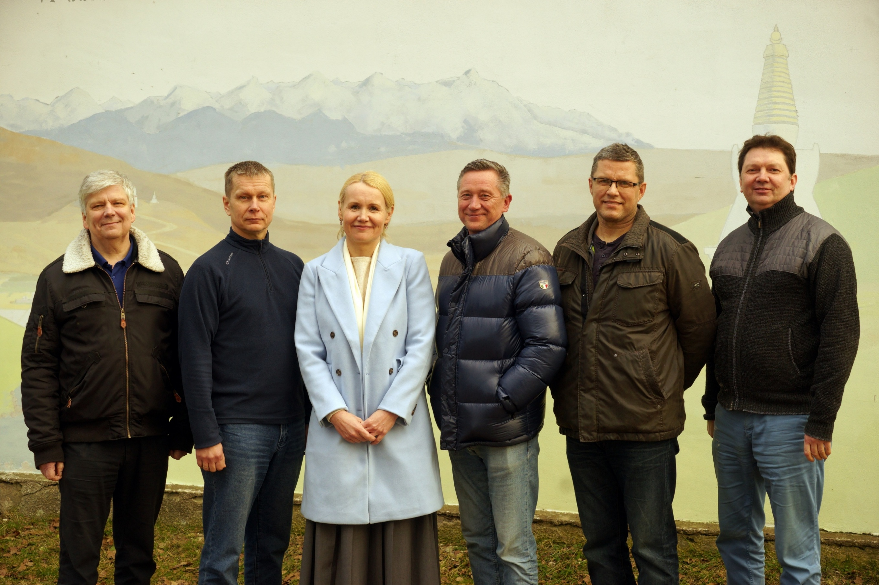
Our roots: A Legacy of Trust Spin-off from VOLIS, Estonia’s first local-level e-voting system. Multidisciplinary team with deep experience in: - Digital governance, secure communications - Public sector leadership - Software development and user-centric design We know what works—and what needs to change
Kerli Elbrecht, Kristina Vain, David Schryer, Jako Jaagu, Hillar Kalam, Peeter Einbaum, Siim Valmar Kiisler, Henri Pook
Notes:
Understanding the problem is crucial for identifying the opportunity for our startup. We will highlight the market gap that exists and discuss the challenges customers currently face.

Slide 8
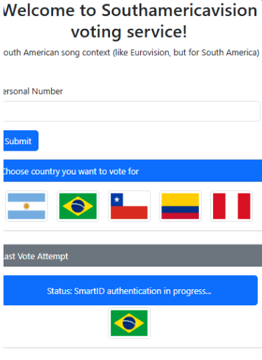
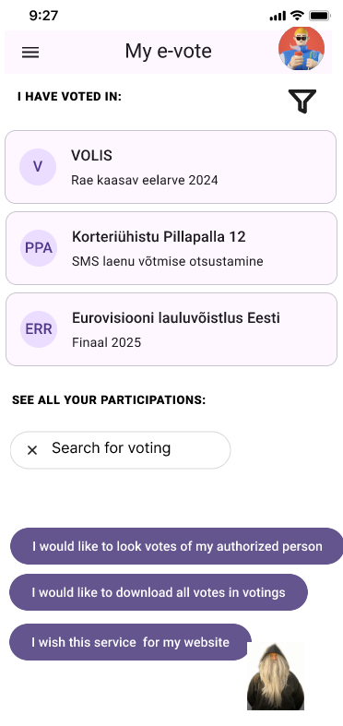
Where We Are Today? ✅ Functional Prototype – live in test environments ✅ Mobile App Prototype – centralized vote access ✅ Early Client Engagements – insights from target users 🛠 Finetuning with first partners 💸 Preparing to go live – early adopters and strategic support welcome.
(Initial investment goal: €300K)
Notes:
It's important to highlight where we currently stand in our startup journey. This section will cover our milestones and the progress we have made.

Slide 9
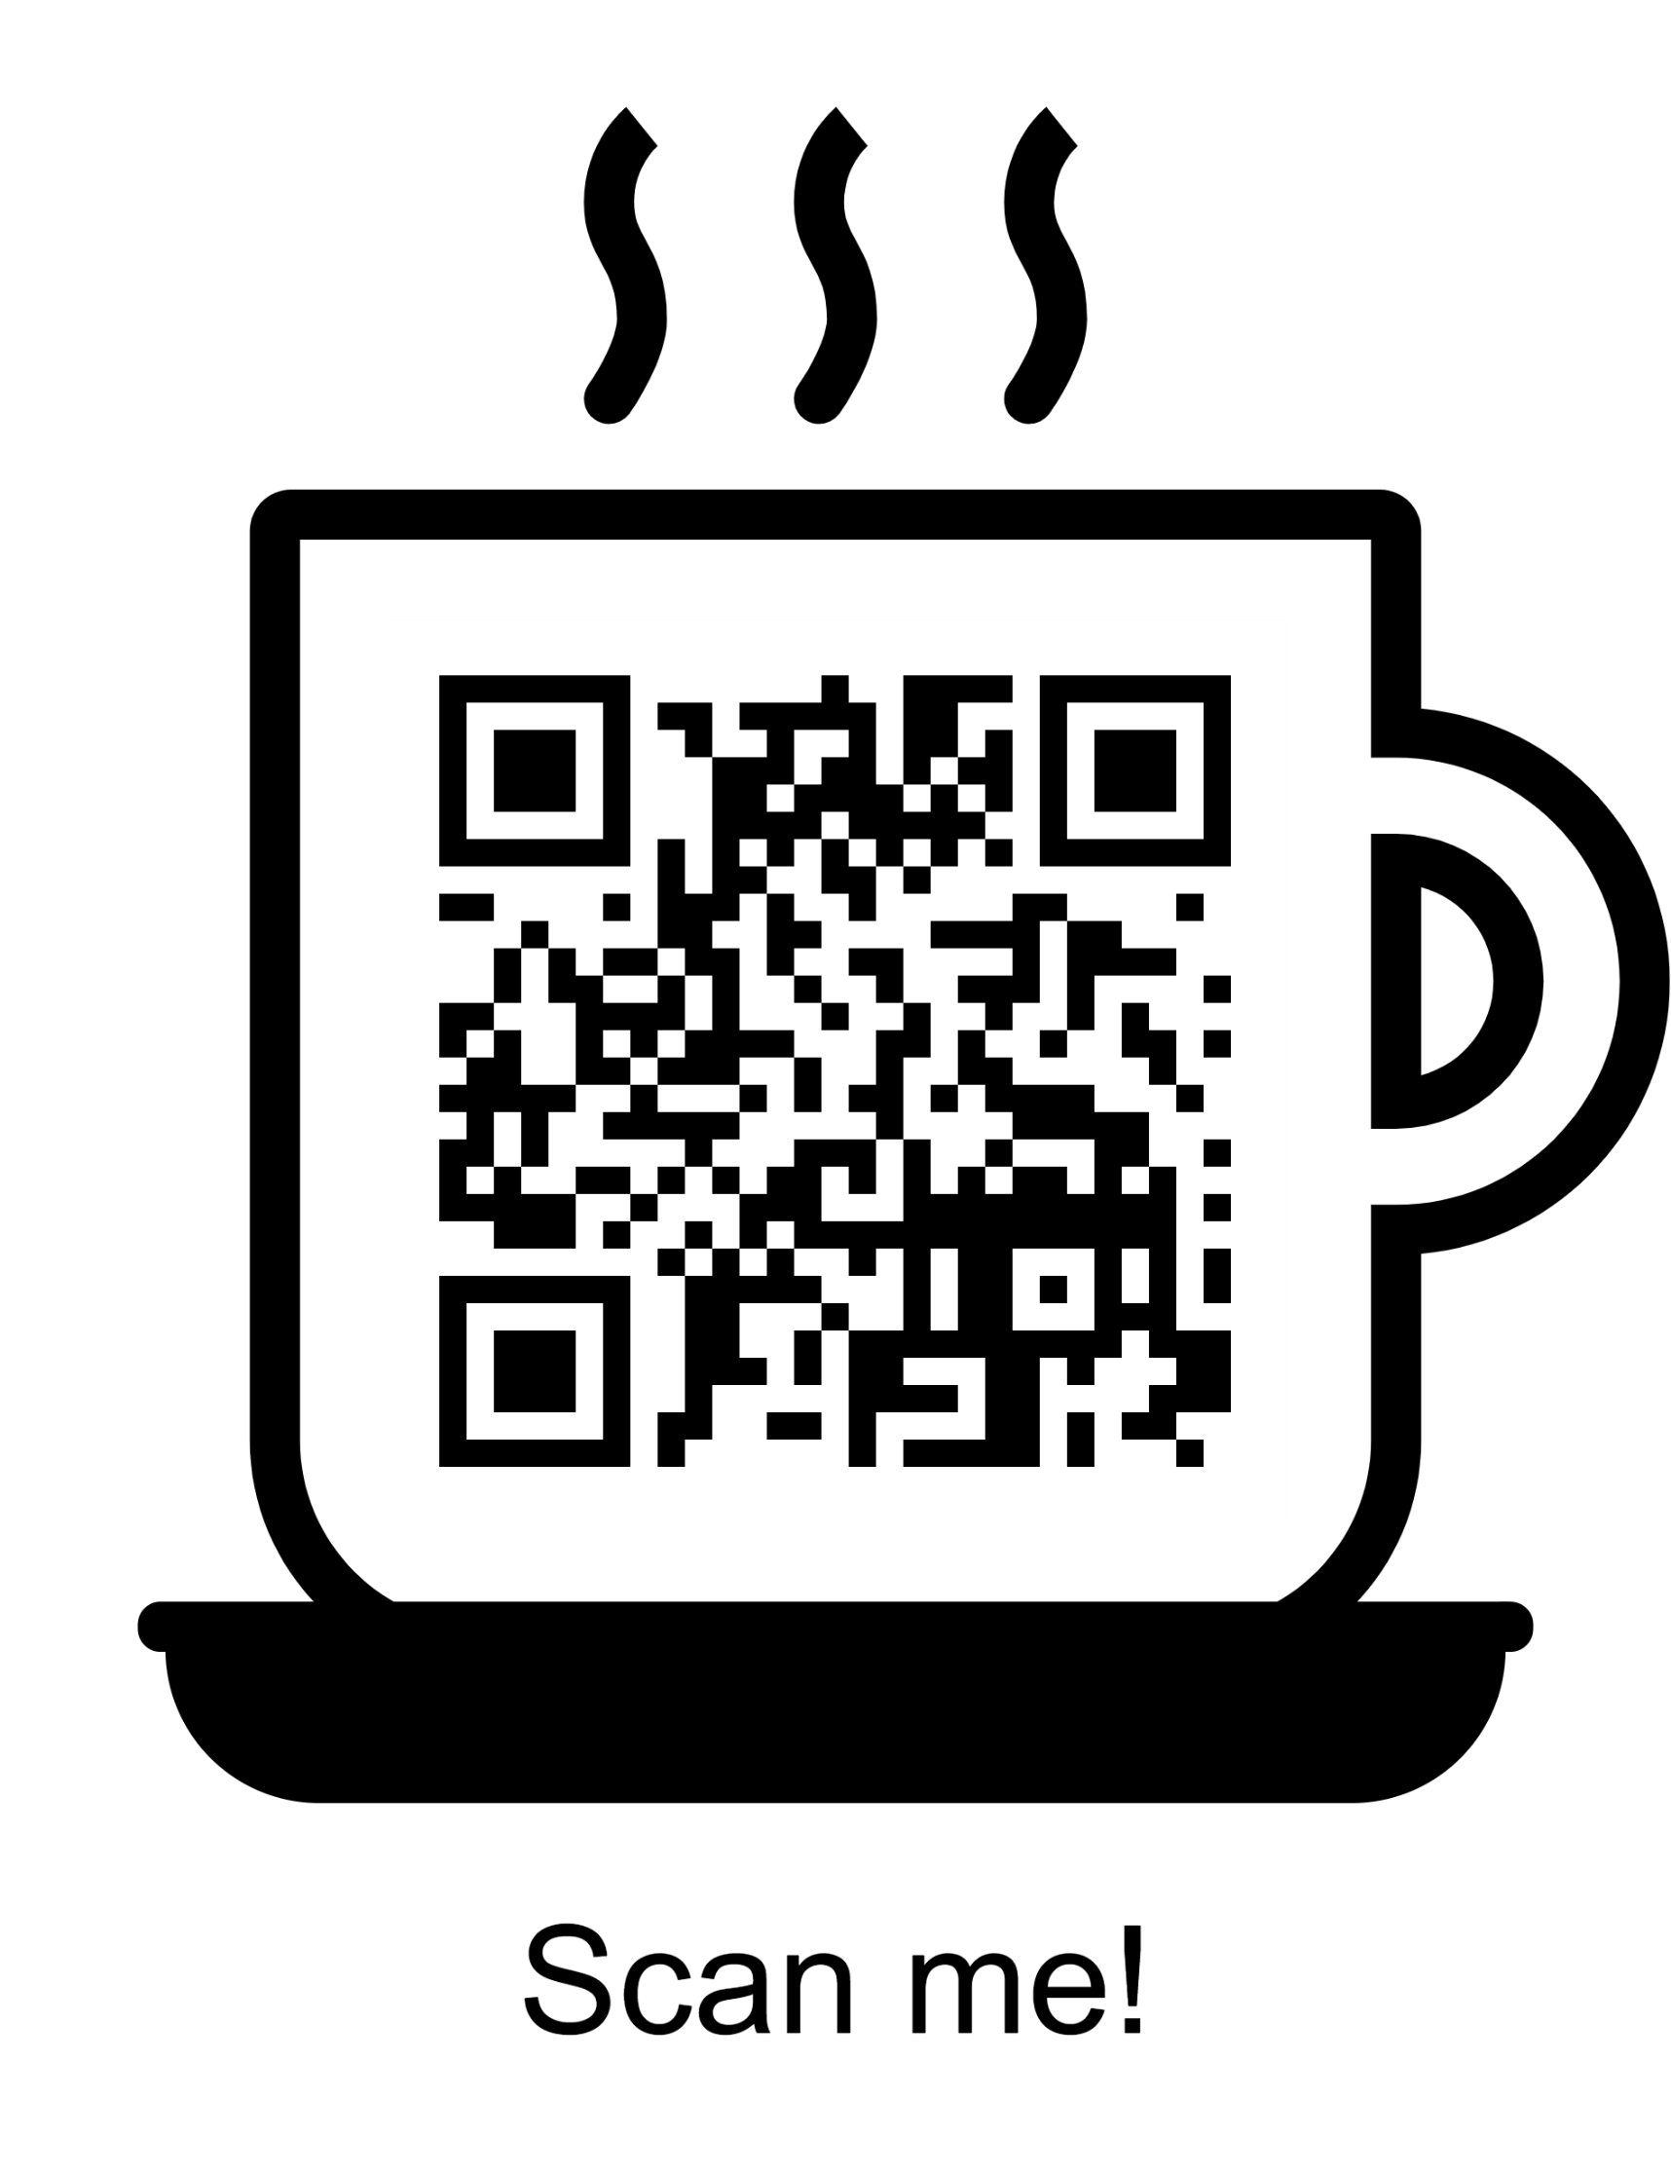
Let’s Make Voting Work for Everyone Looking for partners to make secure, simple, scalable voting a reality. If you run elections, boards, or research—don’t reinvent the wheel. We already built it. 📩 info@elektit.com 🌐 www.elektit.com
Not for espresso macchiato

Slide 10
e-Vote works for the people who vote: - Vote from anywhere – phone or laptop - Security equal to online banking - Track all past votes in one app Familiar. Simple. Trusted.
The Voter Experience

